Slide 1
資訊安全 Chapter 3 User Authentication 使用者身份驗證
Joseph Deng
josephdeng@g2.usc.edu.tw

Slide 2
Outline 大綱
Digital User Authentication Principles
Password-Based Authentication
Token-Based Authentication
Biometric Authentication
Remote-User Authentication
Security Issues for User Authentication
Practical Application: An Iris Biometric System
Case Study: Security Problems for ATM Systems

Slide 3
Learning Objectives 學習目標
The four general means of authenticating a user’s identity.
The mechanism by which hashed passwords are used for user authentication.
The use of the Bloom filter in password management.
An overview of token-based user authentication.
The issues involved and the approaches for remote user authentication.
The key security issues for user authentication.

Slide 4
Definition: Digital User Authentication
NIST SP 800-63-3 (Digital Authentication Guideline, October 2016) defines digital user authentication as:
The process of establishing confidence in user identities that are presented electronically to an information system.
The user must be registered with the system. 必先註冊
An applicant applies to a registration authority (RA 註冊中心) to become a subscriber of a credential service provider (CSP 證書服務提供者).
The CSP issues some sort of electronic credential to the subscriber.
The credential can be verified when presented to the verifier in an authentication transaction.

Slide 5
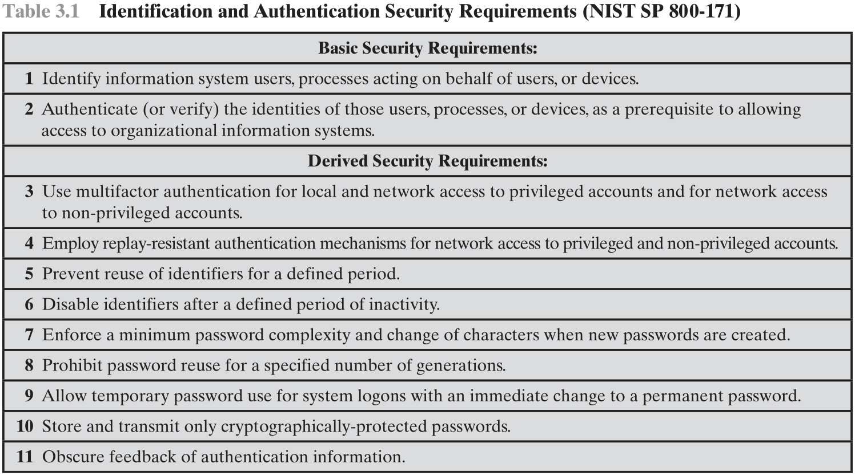
防範 Replay 攻擊
每一個 Session 的 Token ID 不重複
閒置逾時自動登出
密碼複雜度
不可重複使用舊密碼
忘記密碼
加密
模糊化

Slide 6
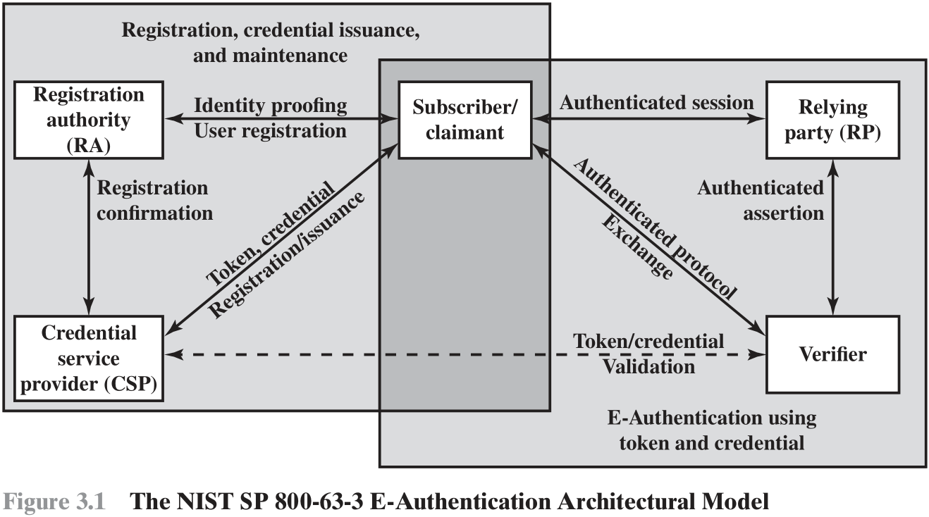
請求者
驗證者

Slide 7
實踐大學
YouTube
Google

Slide 8
The 4 Means of Authentication
Something the individual knows: password, personal identification number (PIN), answers to a prearranged set of questions.
Something the individual possesses: electronic keycards, smart cards, physical keys. (the token)
Something the individual is (static biometrics): fingerprint, retina(眼睛虹膜), face
Something the individual does (dynamic biometrics): voice pattern, handwriting characteristics, typing rhythm

Slide 9
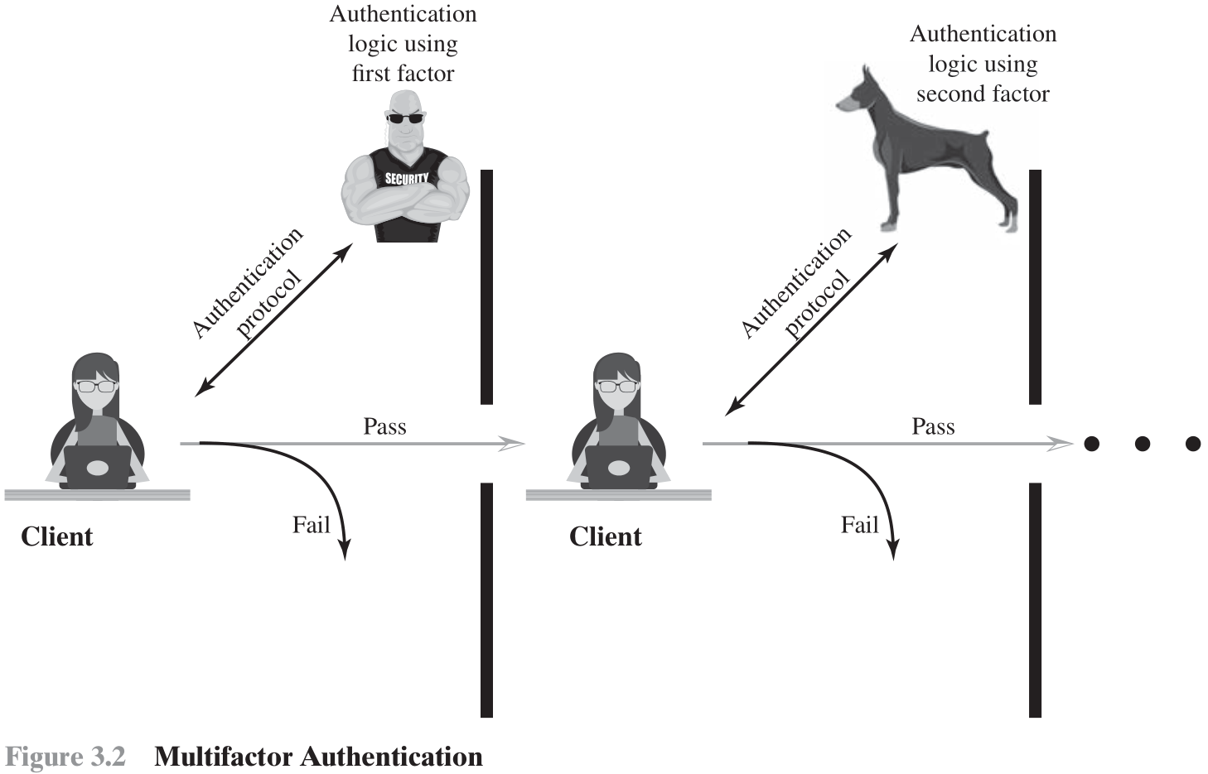

Slide 10
Risk Assessment for User Authentication 風險評估
Assurance Level 信心有多高？
Potential Impact 潛在衝擊程度
Areas of Risk 風險範圍

Slide 11
Assurance Level 信心有多高？
Describes an organization’s degree of certainty that a user has presented a credential that refers to his or her identity
The degree of confidence in the vetting process used to establish the identity of the individual to whom the credential was issued 申請審查過程不出錯
The degree of confidence that the individual who uses the credential is the individual to whom the credential was issued 使用驗證過程不出錯
Four levels of assurance
Little or no confidence in the asserted identity's validity
Some confidence in the asserted identity’s validity
High confidence in the asserted identity's validity
Very high confidence in the asserted identity’s validity

Slide 12
Potential Impact 潛在衝擊程度
FIPS 199 defines three levels of potential impact on organizations or individuals should there be a breach of security:
Low
An authentication error could be expected to have a limited adverse effect on organizational operations, organizational assets, or individuals
Moderate
An authentication error could be expected to have a serious adverse effect 負面影響
High
An authentication error could be expected to have a severe or catastrophic adverse effect

Slide 13
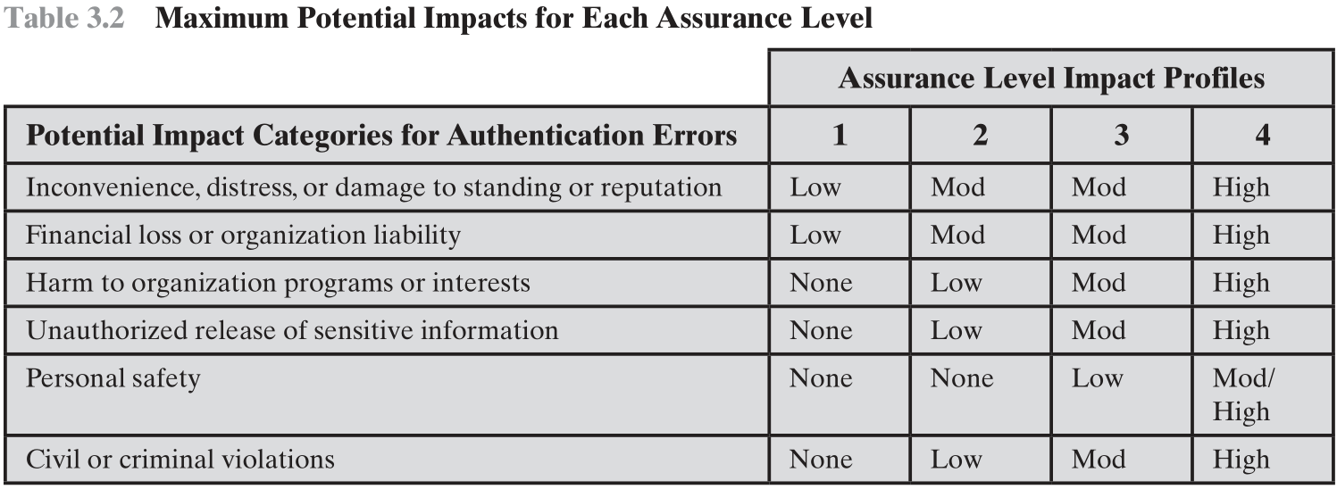
Mapping between Potential Impact and Assurance Level
if the potential impact is low, an assurance level of 1 is adequate
地位 或 聲譽
負債
利益

Slide 14
Password-Based Authentication
Widely used line of defense against intruders
User provides name/login and password
System compares password with the one stored for that specified login
The user ID:
Determines that the user is authorized to access the system 識別
Determines the user’s privileges 權限
Is used in discretionary access control 存取控制

Slide 15
Password Vulnerabilities 脆弱
Offline dictionary attack
Specific account attack
Popular password attack
Password guessing against single user
Workstation hijacking
Exploiting user mistakes
Exploiting multiple password use
Electronic monitoring

Slide 16
Password Vulnerabilities Offline Dictionary Attack
If an attacker can access the password file…
Compare the password hashes against hashes of commonly used passwords
If a match is found, the attacker can gain access by that ID/password combination
Countermeasures
Prevent unauthorized access to the password file
Intrusion detection measures to identify a compromise
Rapid reissuance of passwords

Slide 17
Password Vulnerabilities Specific Account Attack
The attacker targets a specific account and submits password guesses until the correct password is discovered.
The standard countermeasure: account lockout
Locks out access to the account after a number of failed login attempts.
Typical practice is no more than five access attempts.

Slide 18
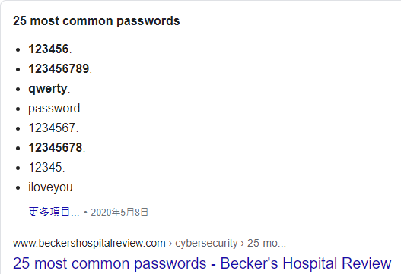
Password Vulnerabilities Popular Password Attack
Use popular passwords and try it against a wide range of user IDs.
Countermeasures
Inhibit the selection by users of common passwords
Scanning the IP addresses of authentication requests and client cookies for submission patterns.

Slide 19
Password Vulnerabilities Password Guessing Against Single User
The attacker attempts to gain knowledge about the account holder and system password policies and uses that knowledge to guess the password.
Countermeasures
Training in
Enforcement of password policies that make passwords difficult to guess
Minimum length of the password
Character set,
Prohibition against using well-known user identifiers,
Length of time before the password must be changed (Password Aging)

Slide 20
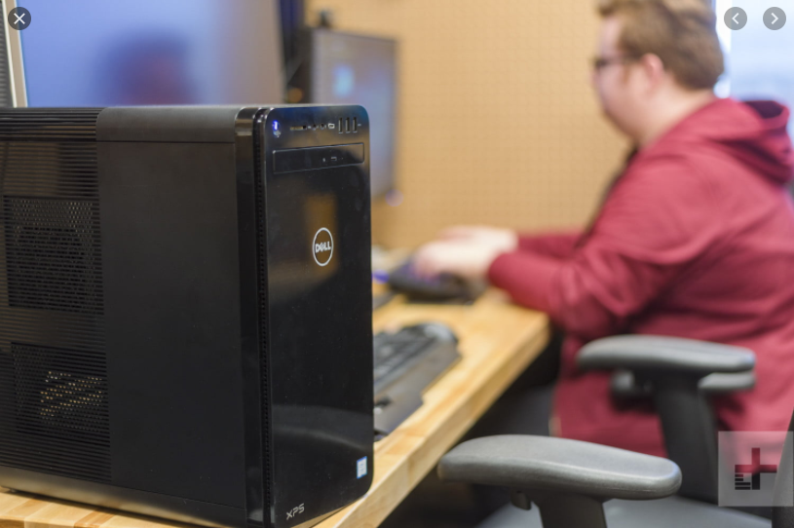
Password Vulnerabilities Workstation Hijacking
The attacker waits until a logged-in workstation is unattended.
Countermeasure
Automatically logout after a period of inactivity
Screensaver
Intrusion detection schemes can be used to detect changes in user behavior

Slide 21

Password Vulnerabilities Exploiting User Mistakes
Social Engineering 社交工程
Many computer systems are shipped with preconfigured passwords for system administrators
系統回復出廠狀態後的預設密碼
Countermeasures
User training
Intrusion detection
Passwords combined with another authentication mechanism

Slide 22
Password Vulnerabilities Exploiting Multiple Password Use
If different network devices share the same or a similar password for a given user.
你的 Google 帳號、YouTube 帳號、Facebook 帳號、Instagram 帳號、校務系統帳號、…
帳號名稱是否全部相同？
密碼是否全部相同？
每隔多久更換密碼？

Slide 23
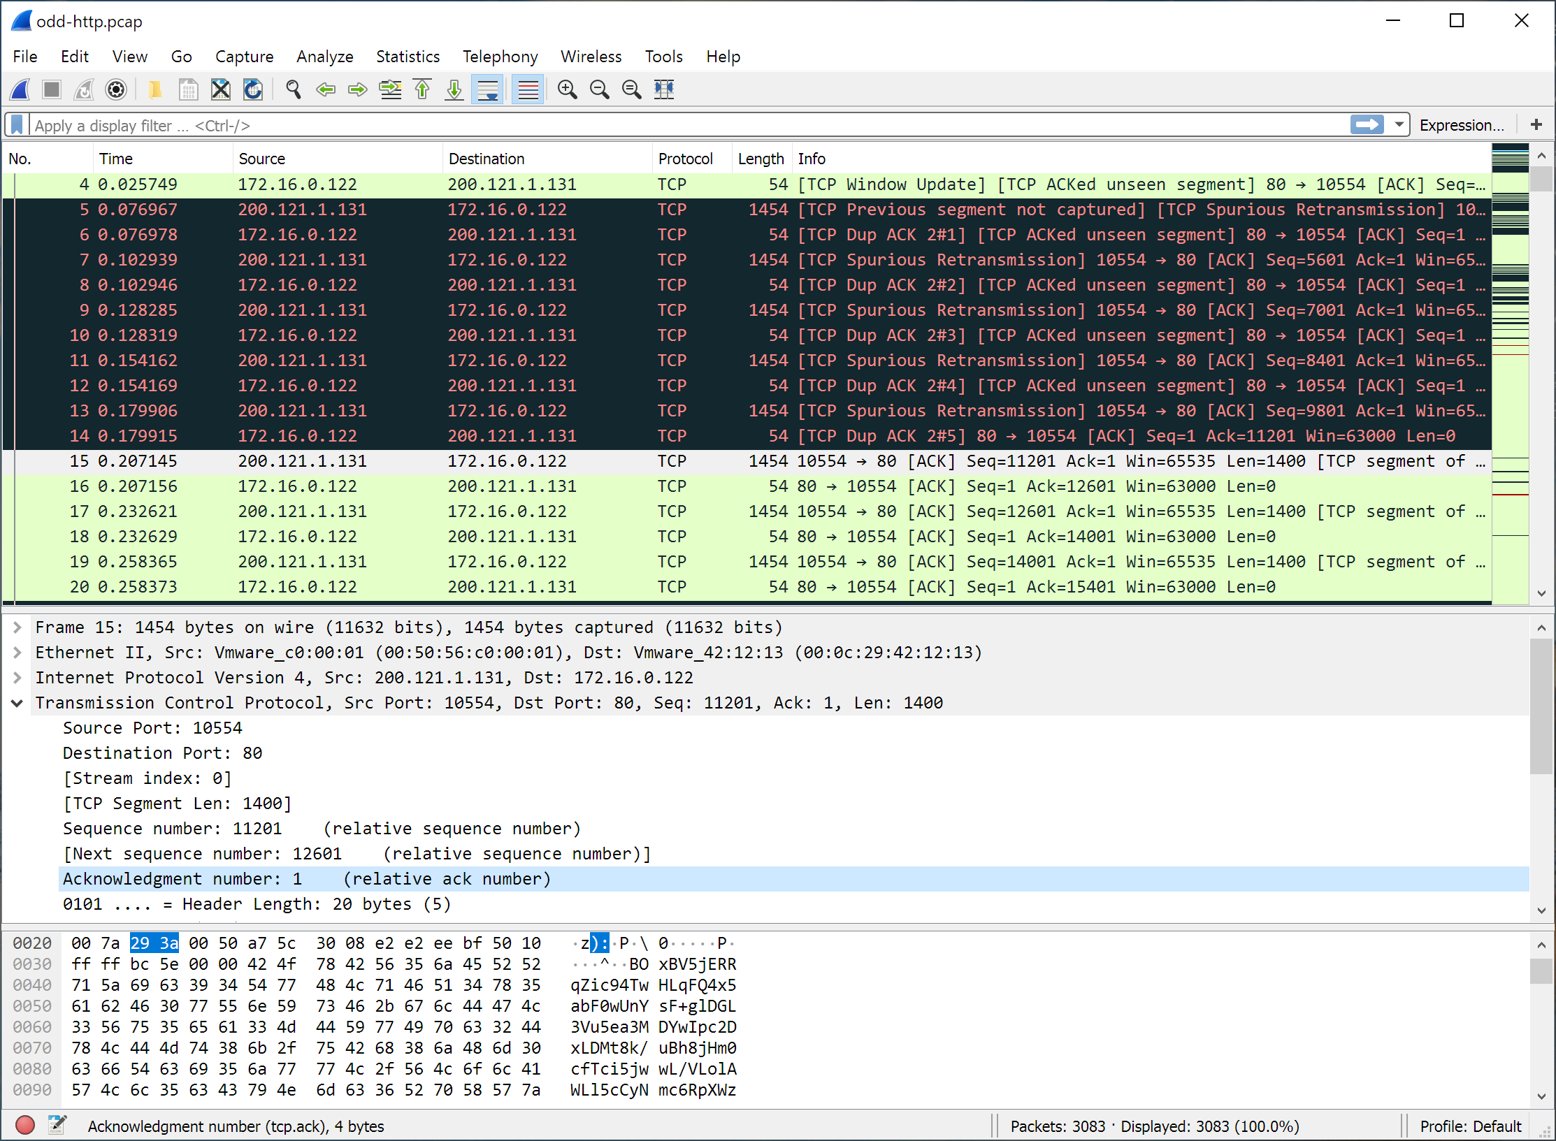
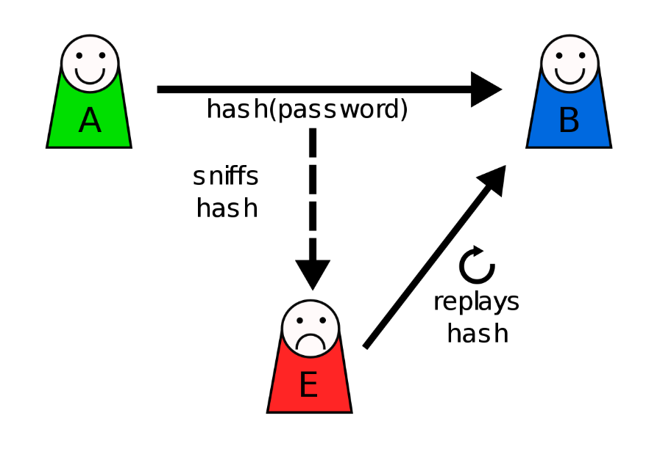

Password Vulnerabilities Electronic Monitoring
If passwords is transmitted across networks to log on remote systems
Simple encryption will not fix this problem, because the encrypted password is, in effect, the password and can be observed and reused by an adversary

Slide 24
方案
Single sign-on(SSO)
登入一次之後，進入其他相關系統不必再登入
Automated password managers
使用者不必再自己記憶密碼
Use complex passwords generated by computers that no human can remember

Slide 25
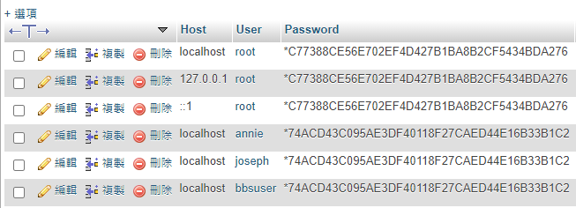
The Use of Hashed Passwords
Do not store passwords in plaintext!
Use a hash function before storing passwords
SELECT COUNT(*) FROM `user` WHERE `User`='$account' AND `Password`=PASSWORD('$password')

Slide 26
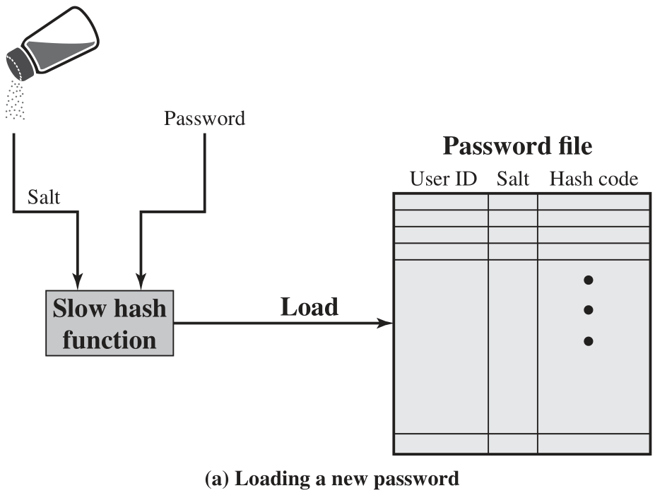
UNIX Password Scheme 建立密碼
相同的密碼
產生不同的
Hash code

Slide 27
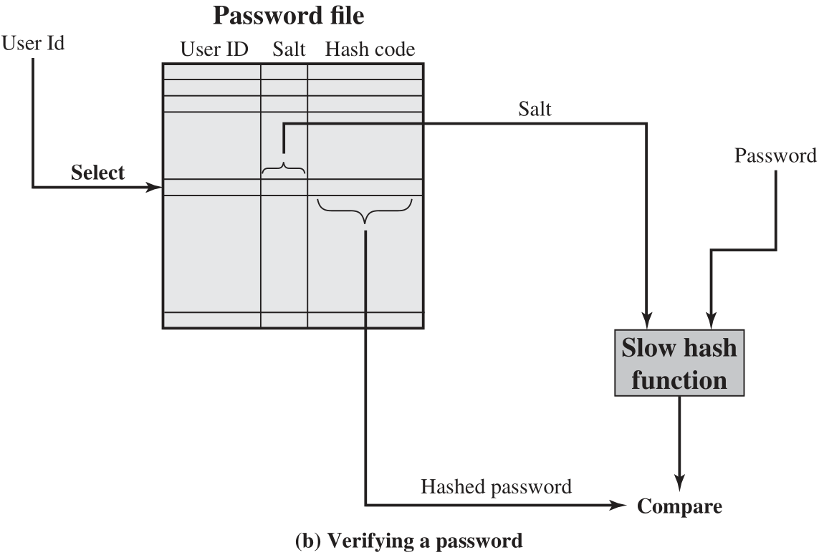
UNIX Password Scheme 驗證密碼

Slide 28
UNIX Implementations
密碼長度 8 個字元，轉成 56 Bits（1 個字元 7 Bits, 古老的ASCII）
The hash routine, known as crypt(3), is based on DES.
A 12-bit salt value is used.
1 個字元變成 8 Bits 之後
64-bit data block
The encryption process is repeated for a total of 25 times
The resulting 64-bit output is translated into an 11-character sequence.
The crypt(3) routine is designed to discourage guessing attacks. Software implementations of DES are slow compared to hardware versions, and the use of 25 iterations multiplies the time required by 25.

Slide 29
UNIX Implementations Improved
The recommended hash function for many UNIX systems, including Linux, Solaris, and FreeBSD is based on the MD5
Salt value up to 48 bits
No limitations on password length
Produces a 128-bit hash value
Far slower than crypt(3). MD5 crypt uses an inner loop with 1000 iterations
OpenBSD uses a hash function based on Blowfish symmetric block cipher
The hash function, called Bcrypt, is quite slow to execute.
Password length up to 55 characters
A random salt value of 128 bits, to produce a 192-bit hash value.
Cost variable
Configurable
Increase in the time required to perform a Bcyrpt hash

Slide 30
Password Cracking 傳統手法
Dictionary attacks 字典攻擊
Develop a large dictionary of possible passwords and try each against the password file
Each password must be hashed using each salt value and then compared to stored hash values
Rainbow table attacks 彩虹表攻擊
Pre-compute tables of hash values for all salts
A mammoth table of hash values
Can be countered by using a sufficiently large salt value and a sufficiently large hash length
Password crackers exploit the fact that people choose easily guessable passwords
Shorter password lengths are also easier to crack 沒有最懶，只有更懶！
John the Ripper 專業工具
Open-source password cracker first developed in in 1996
Uses a combination of brute-force and dictionary techniques

Slide 31
Modern Approaches 現代方法
Complex password policy
Forcing users to pick stronger passwords
However password-cracking techniques have also improved
The processing capacity available for password cracking has increased dramatically
The use of sophisticated algorithms to generate potential passwords
Studying examples and structures of actual passwords in use

Slide 32
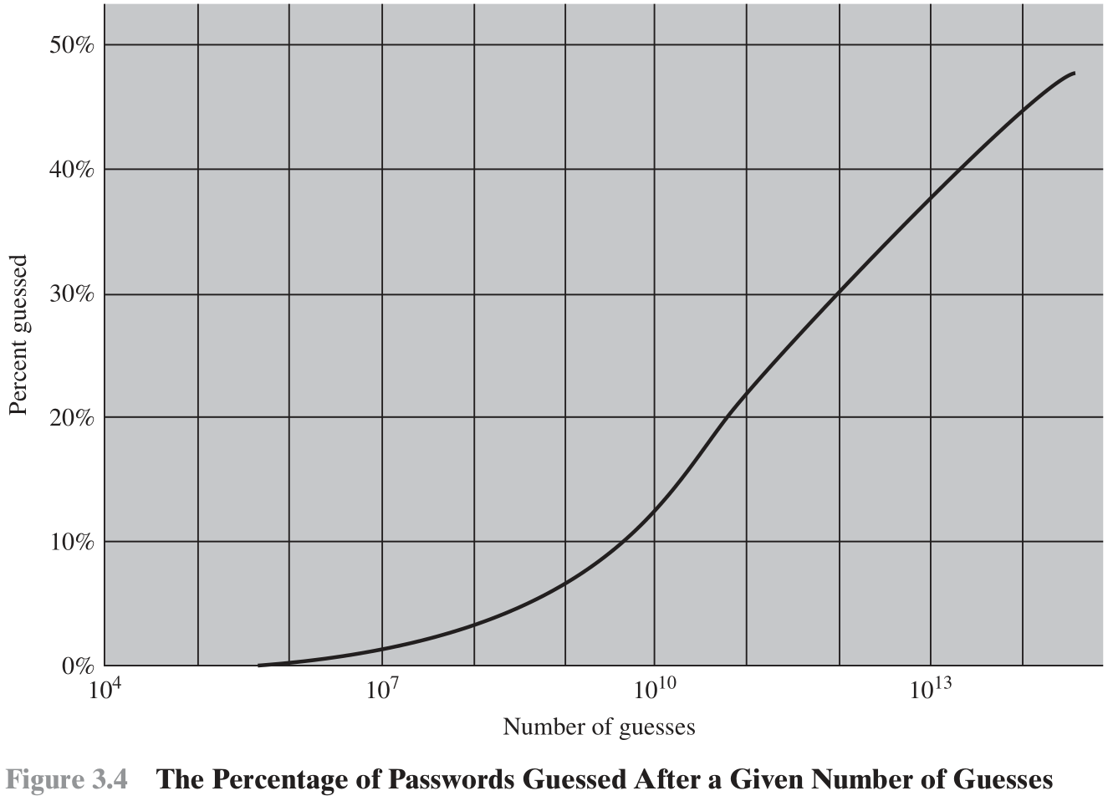
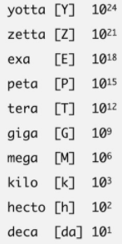

Slide 33
Password File Access Control
Can block offline guessing attacks by denying access to encrypted passwords
Make available only to privileged users
Shadow password file
Vulnerabilities
Weakness in the OS that allows access to the file
Accident with permissions making it readable
Users with same password on other systems
Access from backup media
Sniff passwords in network traffic

Slide 34
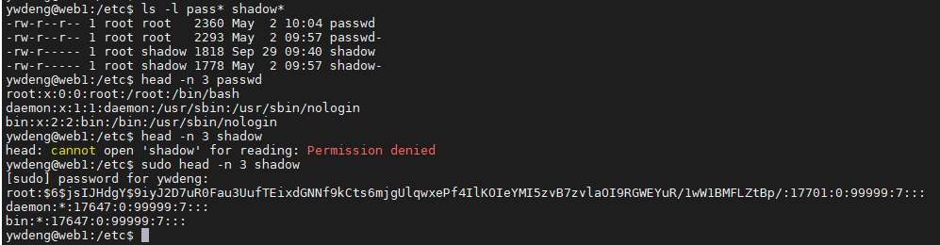
Password File Access Control
勿將密碼紀錄在帳號檔裡面
密碼另存一個檔案
Shadow Password File
設定特殊存取限制，只有系統管理員能夠讀取檔案內容

Slide 35
Password Selection Strategies
User education 教育
Users can be told the importance of using hard to guess passwords and can be provided with guidelines for selecting strong passwords
Computer generated passwords 類似亂碼
Users have trouble remembering them
Reactive password checking
System periodically runs its own password cracker to find guessable passwords
Complex password policy
User is allowed to select their own password, however the system checks to see if the password is allowable, and if not, rejects it
Goal is to eliminate guessable passwords while allowing the user to select a password that is memorable

Slide 36
Proactive Password Checking 主動檢查
Rule enforcement
Specific rules that passwords must adhere to
Password checker
Compile a large dictionary of passwords not to use
Bloom filter
Used to build a table based on hash values 節省密碼字典的儲存空間
Check desired password against this table 加速搜尋速度

Slide 37
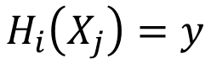
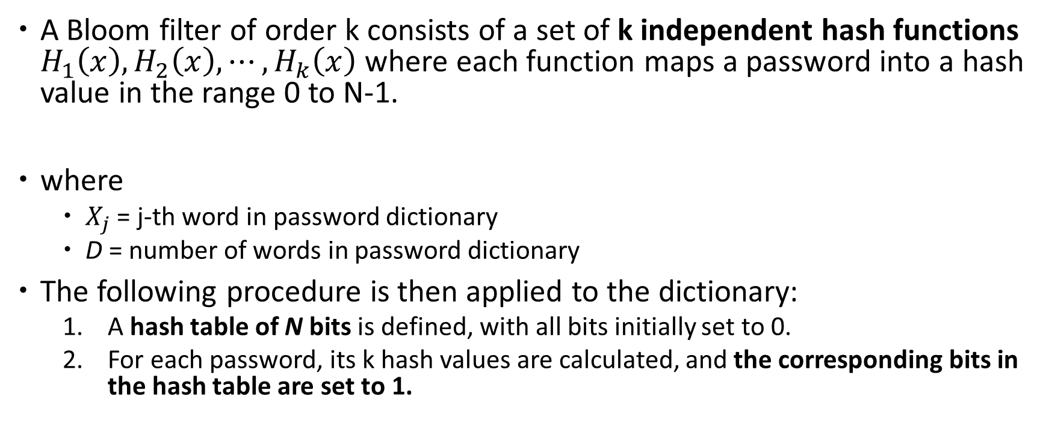
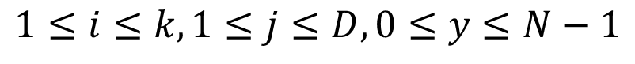
Bloom Filter
A Bloom filter of order k consists of a set of k independent hash functions $H_{1}\left(x\right),H_{2}\left(x\right),⋯,H_{k}\left(x\right)$ where each function maps a password into a hash value in the range 0 to N-1.
where
$X_{j}$ = j-th word in password dictionary
D = number of words in password dictionary
The following procedure is then applied to the dictionary:
A hash table of N bits is defined, with all bits initially set to 0.
For each password, its k hash values are calculated, and the corresponding bits in the hash table are set to 1.
$$H_{i}\left(X_{j}\right)=y$$
$$1≤i≤k,1≤j≤D,0≤y≤N−1$$
k個Hash Function,
字典裡有D個字，Hash Table 有 N 個 Bit（Bit Map）

Slide 38
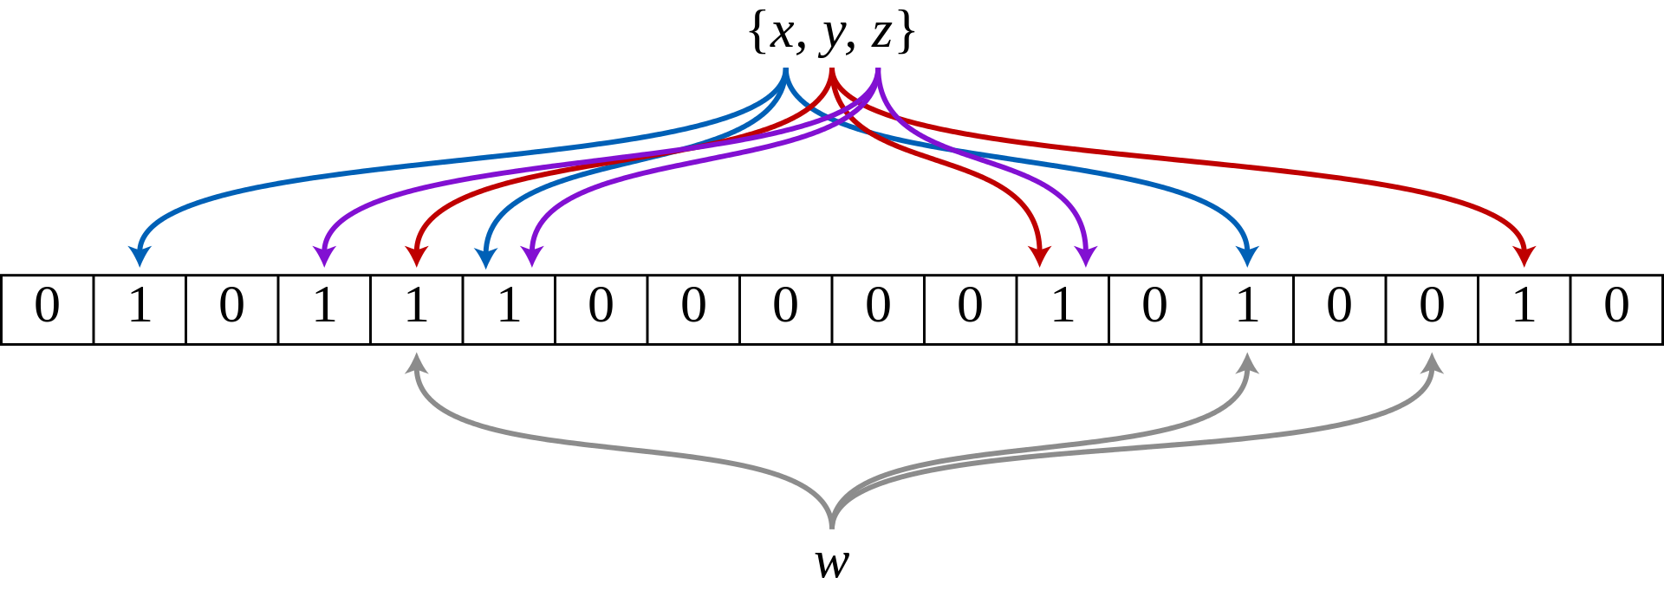
Bloom Filter (cont’d)
An example of a Bloom filter, representing the set {x, y, z} .
The colored arrows show the positions in the bit array that each set element is mapped to.
The element w is not in the set {x, y, z} , because it hashes to one bit-array position containing 0.
For this figure, N = 18 and k = 3.

Slide 39
Bloom Filter (cont’d)
When a new password is presented to the checker, its k hash values are calculated.
If all the corresponding bits of the hash table are equal to 1, then the password is rejected.
All passwords in the dictionary will be rejected.

Slide 40
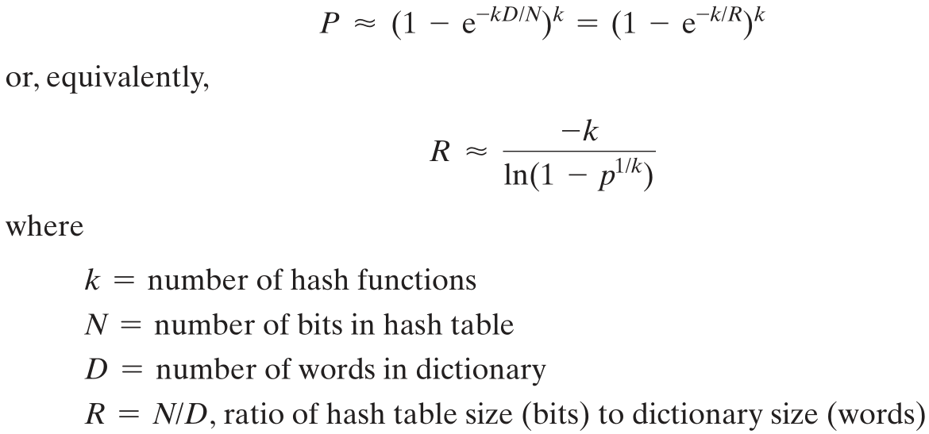
Bloom Filter 誤判
False Positives 誤判：不同的密碼，產生相同的 Hash Value
誤判機率

Slide 41
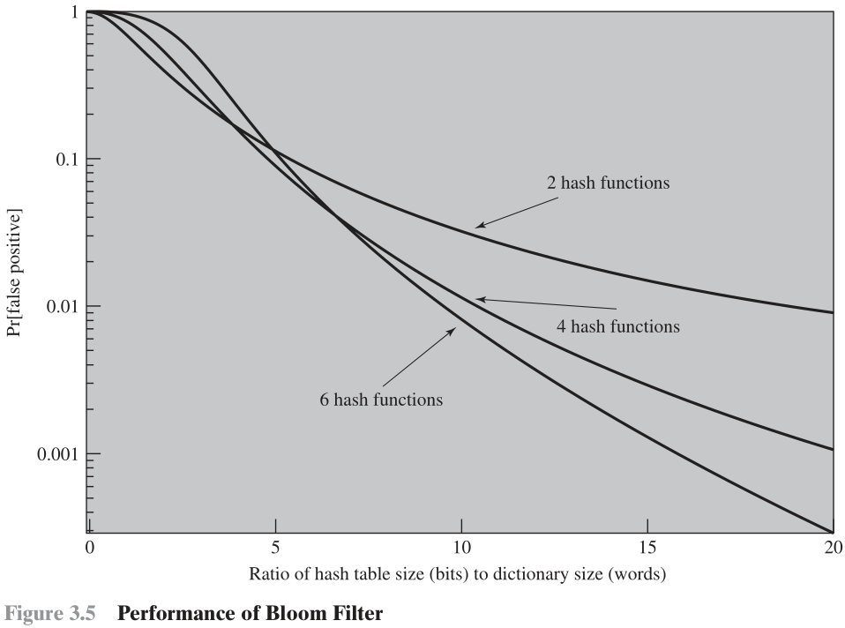
加大 Hash Table Size
和 Hash Function 數量
可以降低誤判機率

Slide 42
Bloom Filter 優點
省空間
Hash table 儲存 1 個字只用 k 個 Bit，不需儲存整個字典
If we choose six hash functions, the required ratio is R = 9.6. Therefore, we need a hash table of 9.6 * 106 bits or about 1.2 MB of storage.
In contrast, storage of the entire dictionary would require on the order of 8 MB. Thus, we achieve a compression of almost a factor of 7.
速度快
Hash function 的計算速度比搜尋快得多
Password checking involves the straightforward calculation of six hash functions and is independent of the size of the dictionary,
Whereas with the use of the full dictionary, there is substantial searching

Slide 43

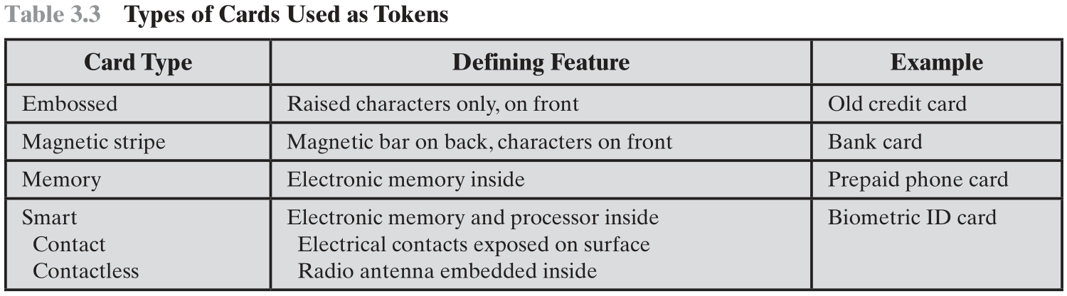
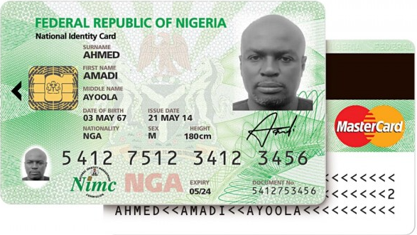
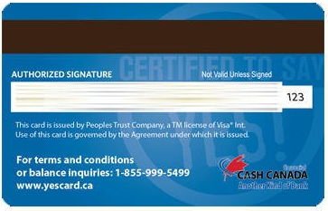
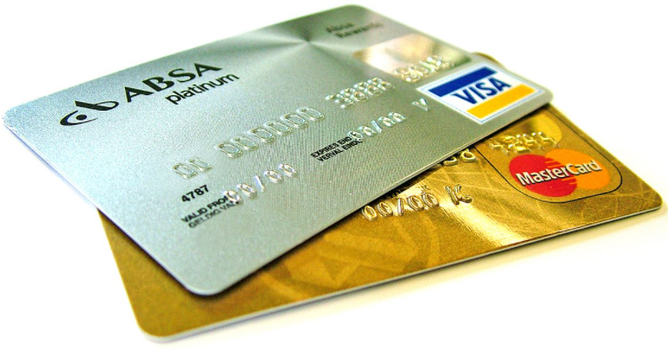
Token-Based Authentication
浮雕紙卡
磁條
記憶卡
智慧卡
接觸式
非接觸式

Slide 44
Memory Cards
Can store but do not process data
The most common is the magnetic stripe card 磁條卡
Can include an internal electronic memory
Can be used alone for physical access
Hotel room
ATM
Provides significantly greater security when combined with a password or PIN
Drawbacks of memory cards include:
Requires a special reader 讀卡機
Loss of token
User dissatisfaction

Slide 45
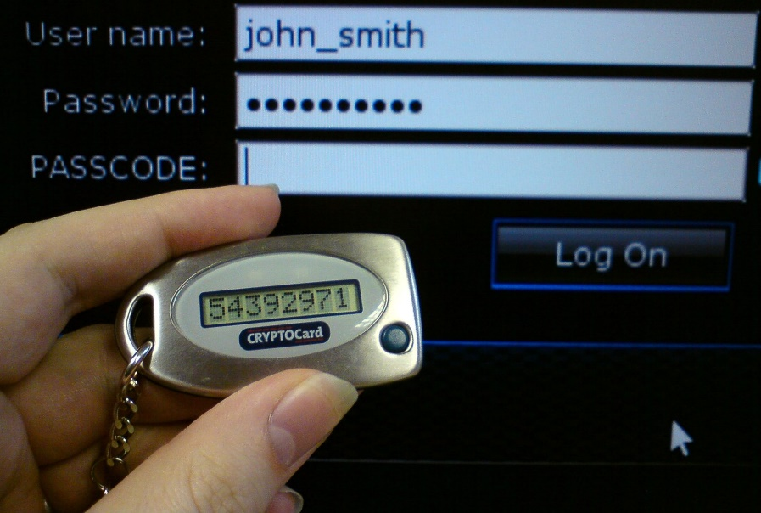
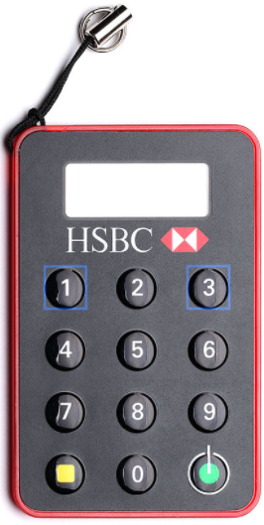
Smart Tokens
Physical characteristics
Include an embedded microprocessor
A smart token that looks like a bank card
Can look like calculators, keys, small portable objects
User interface
Manual interfaces include a keypad and display for human/token interaction
Electronic interface
Contact and contactless interfaces
Authentication protocol:
Static
Dynamic password generator
Challenge-response

Slide 46
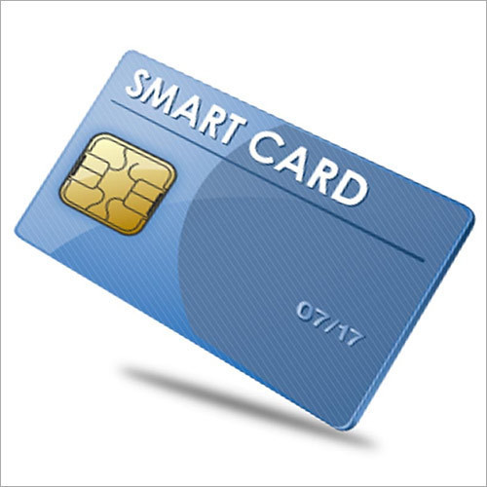
Smart Cards
Most important category of smart token
Has the appearance of a credit card
Has an electronic interface
May use any of the smart token protocols
Contain:
An entire microprocessor
Processor
Memory
I/O ports
Typically include three types of memory:
Read-only memory (ROM)
Stores data that does not change during the card’s life
Electrically erasable programmable ROM (EEPROM)
Holds application data and programs
Random access memory (RAM)
Holds temporary data generated when applications are executed

Slide 47
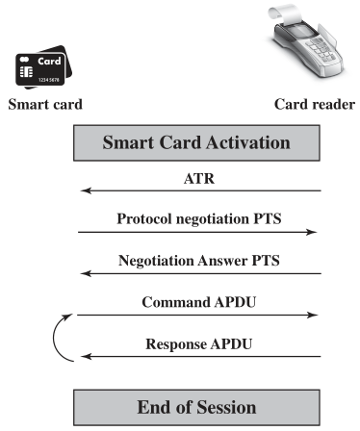
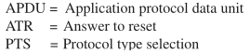

Slide 48
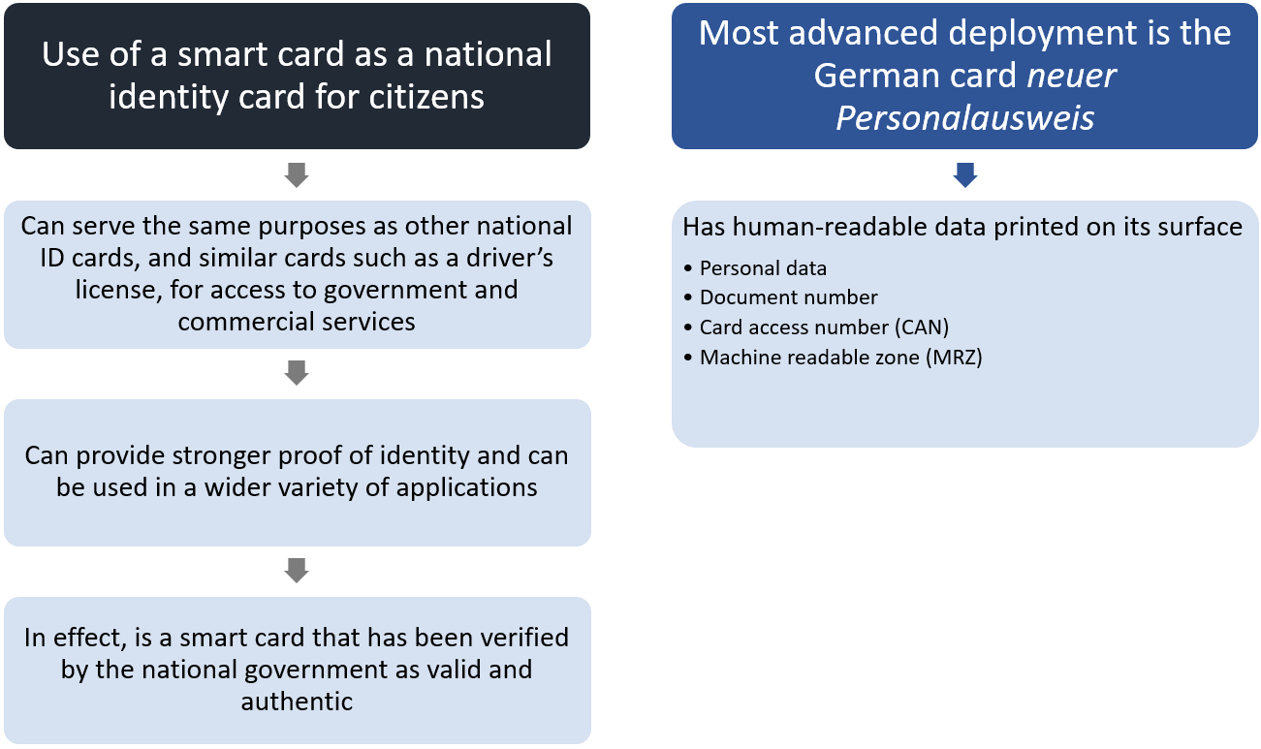
Electronic Identity Cards 電子身份證
electronic identity (eID)

Slide 49
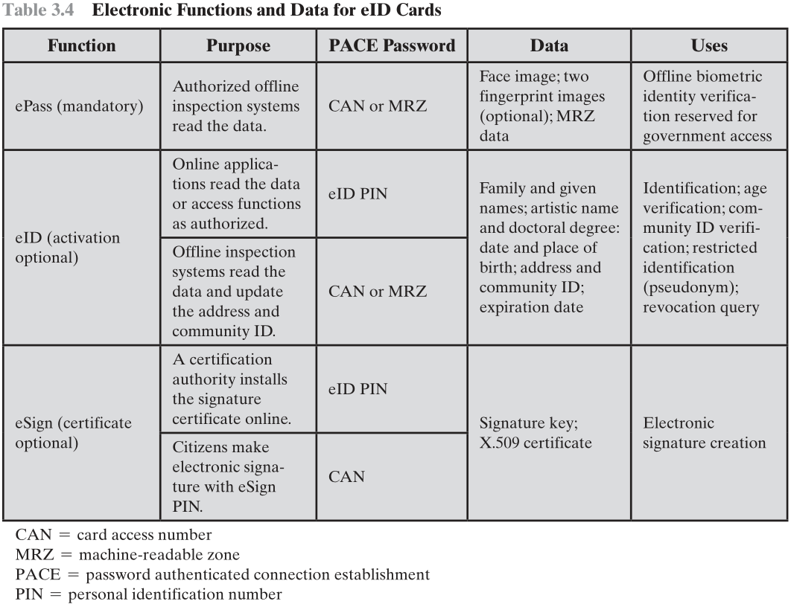

Slide 50
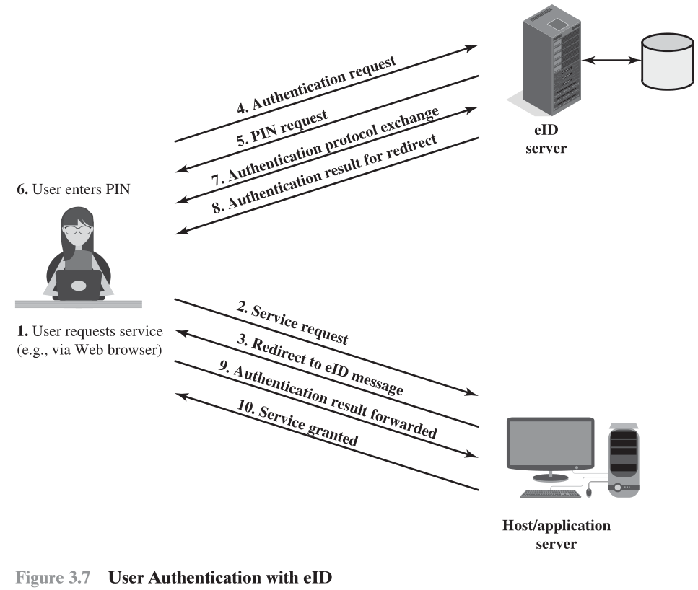

Slide 51
Password Authenticated Connection Establishment (PACE)
Ensures that the contactless RF chip in the eID card cannot be read without explicit access control
For online applications, access is established by the user entering the 6-digit PIN (which should only be known to the holder of the card)
For offline applications, either the MRZ printed on the back of the card or the six-digit card access number (CAN) printed on the front is used

Slide 52
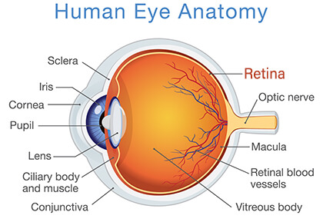
Biometric Authentication 生物特徵認證
Attempts to authenticate an individual based on unique physical characteristics 獨一無二的實體特徵
Based on pattern recognition 圖形辨識
Is technically complex and expensive when compared to passwords and tokens
Physical characteristics used include:
Facial characteristics 臉
Fingerprints 指紋
Hand geometry 掌型
Retinal pattern 視網膜
Iris 虹膜
Signature 簽名筆跡
Voice 語音

Slide 53
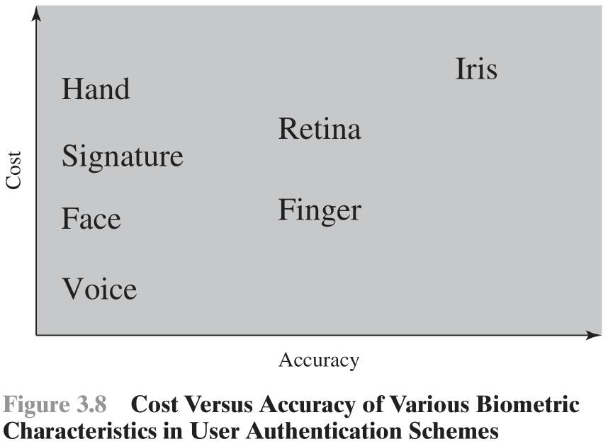

Slide 54
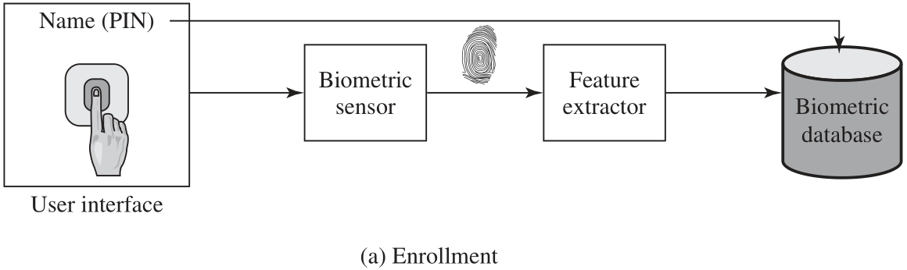
Operation of a Biometric Authentication System: Enroll 註冊/登錄
Enrollment creates an association between a user and the user's biometric characteristics.

Slide 55
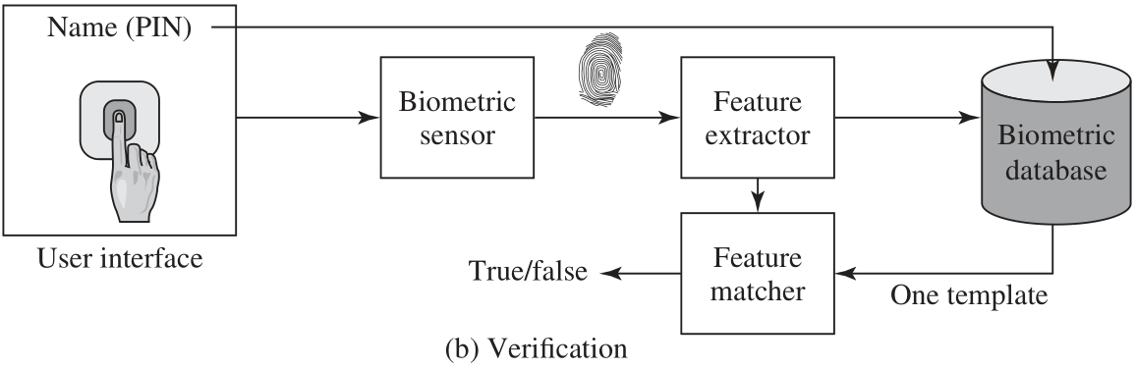
Operation of a Biometric Authentication System: Verify 驗證

Slide 56
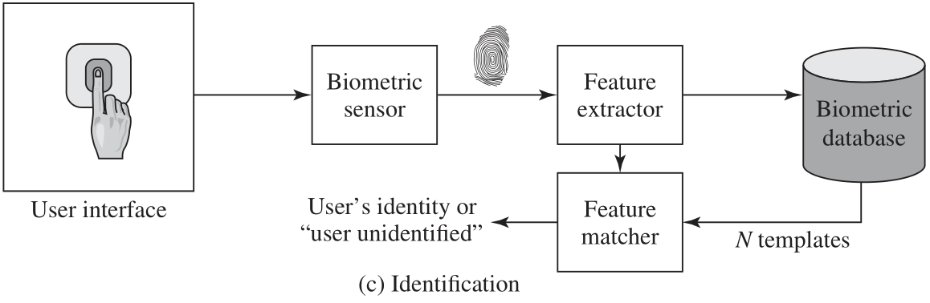
Operation of a Biometric Authentication System: Identify 識別
User authentication either involves verifying that a claimed user is the actual user or identifying an unknown user.

Slide 57
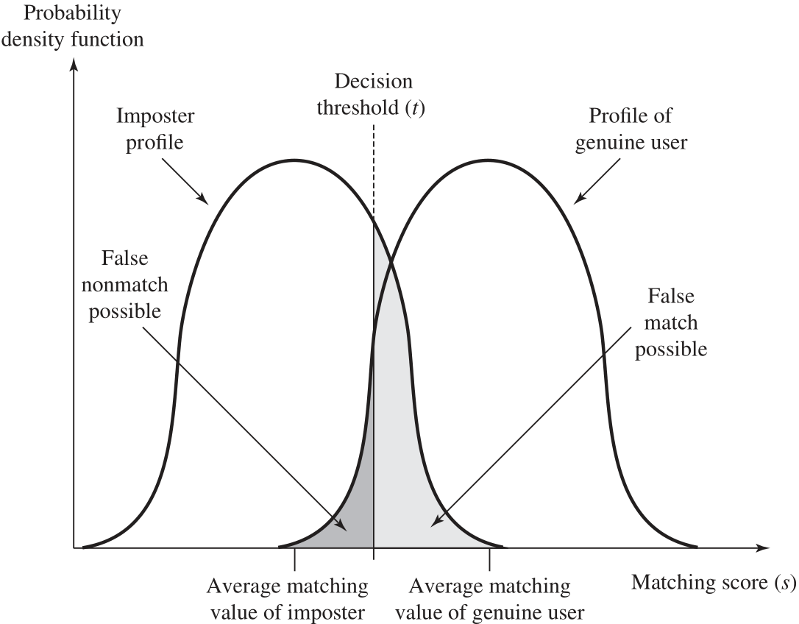
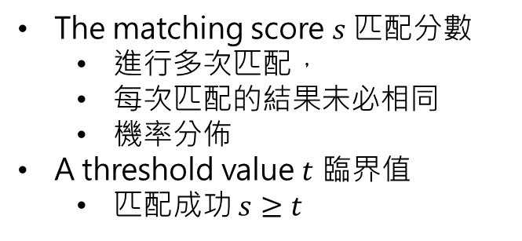
Profiles of a Biometric Characteristic of an Imposter and an Authorized User
冒名頂替者
授權用戶
Biometric Accuracy 準確度
The matching score $s$ 匹配分數
進行多次匹配，
每次匹配的結果未必相同
機率分佈
A threshold value $t$ 臨界值
匹配成功 $s≥t$

Slide 58
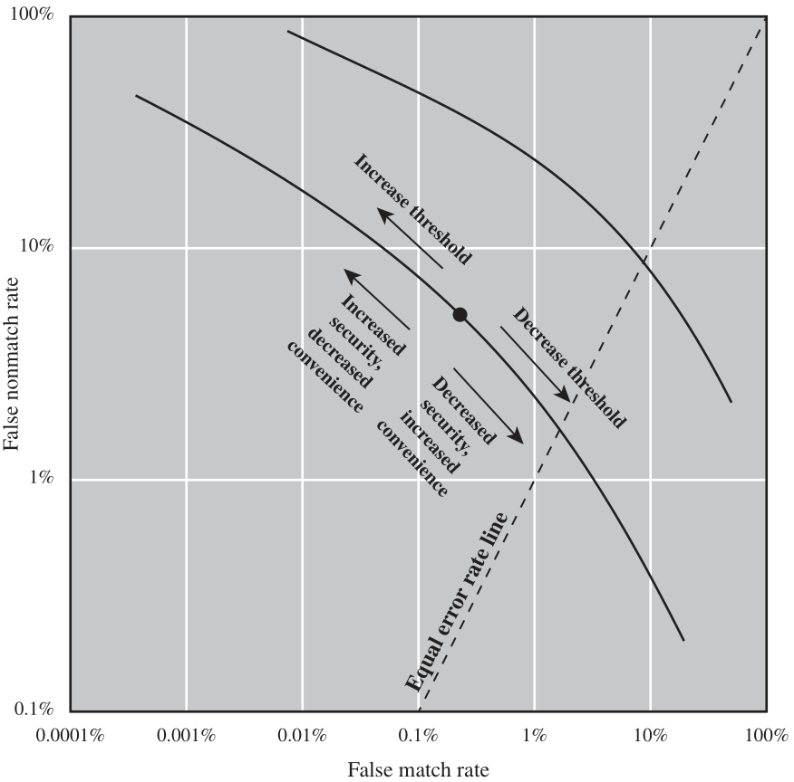
Idealized Biometric Measurement Operating Characteristic Curves (log-log scale)
劣
優

Slide 59
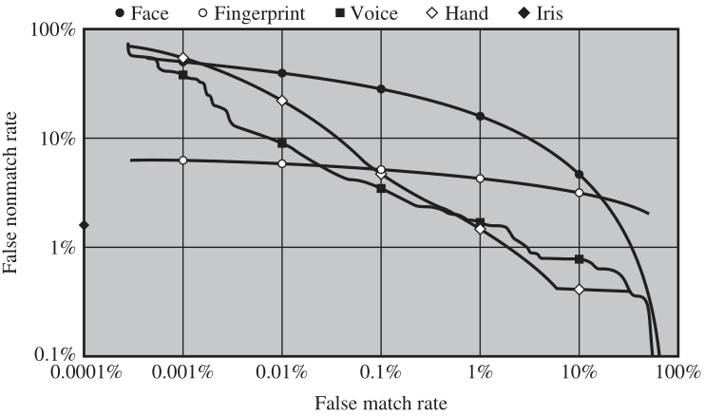
Actual Biometric Measurement Operating Characteristic Curves
虹膜不出錯！

Slide 60
Remote-User Authentication
Security Threats
An eavesdropper being able to capture a password 竊聽
An adversary replaying an authentication sequence that has been observed 重播
To counter threats to remote user authentication, systems generally rely on some form of challenge-response protocol

Slide 61
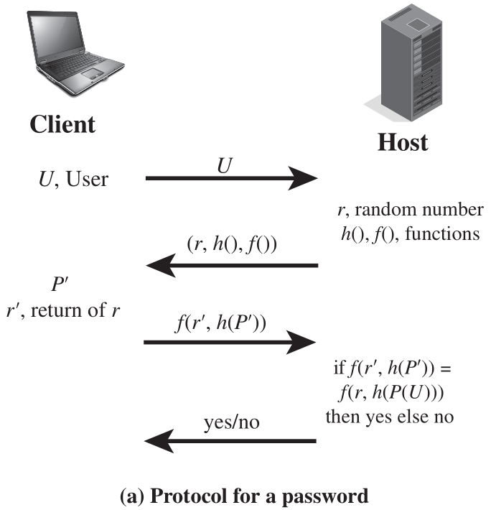
Password Protocol
nonce
使用者輸入的密碼
使用者註冊的密碼

Slide 62
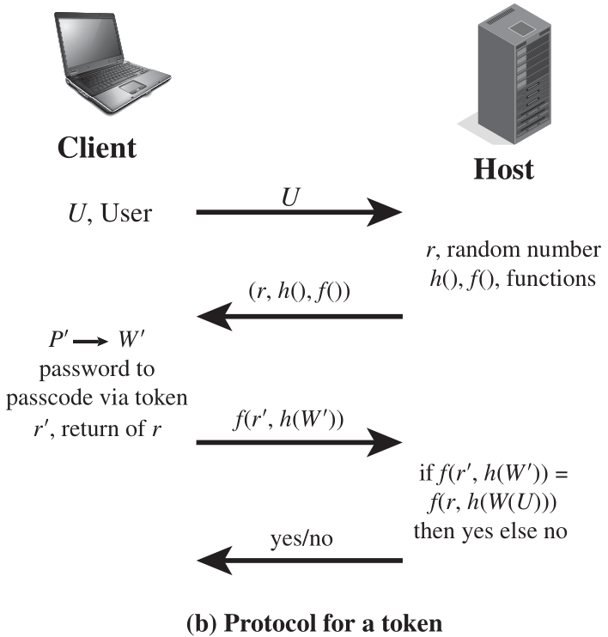
Token Protocol
Token 驗證碼

Slide 63
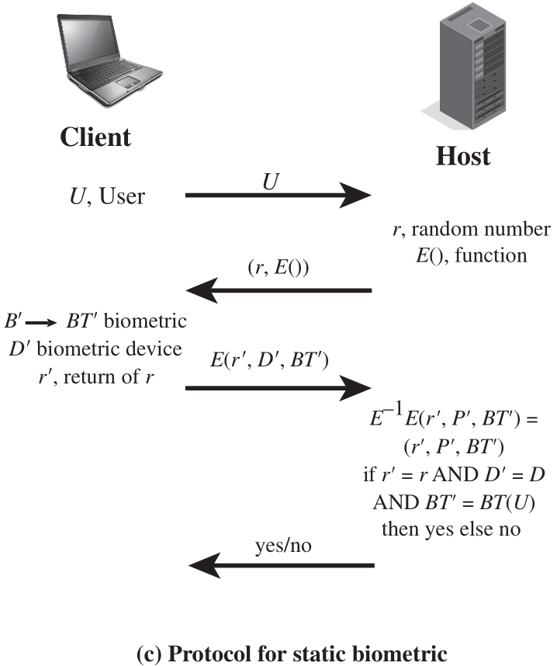

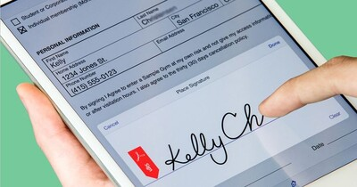
Static Biometric Protocol

Slide 64
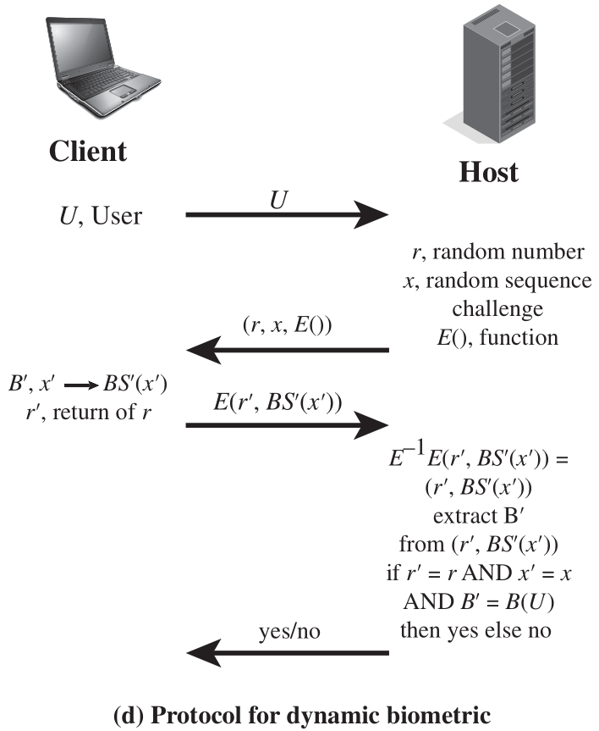
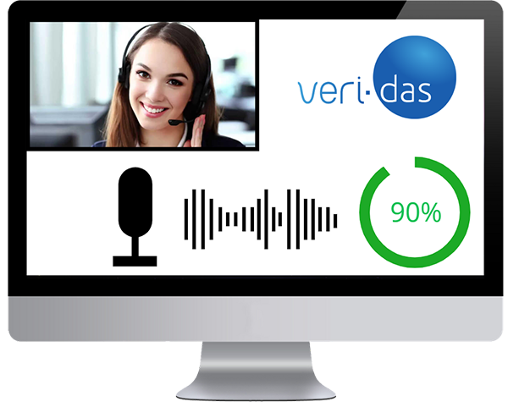
Dynamic Biometric Protocol
The human user at the client end must vocalize (speaker verification), type (keyboard dynamics verification), or write (handwriting verification) the sequence to generate a biometric signal

Slide 65
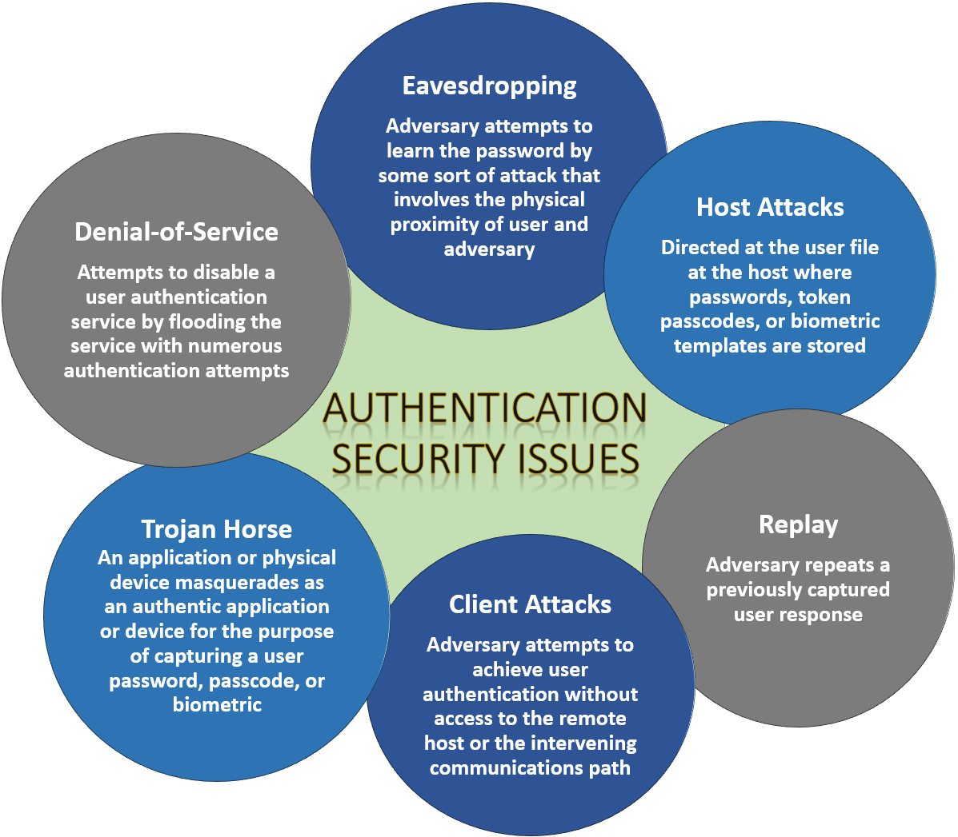
Security Issues for User Authentication
竊聽
阻絕服務
主機攻擊
特洛伊木馬
重播
客戶端攻擊

Slide 66
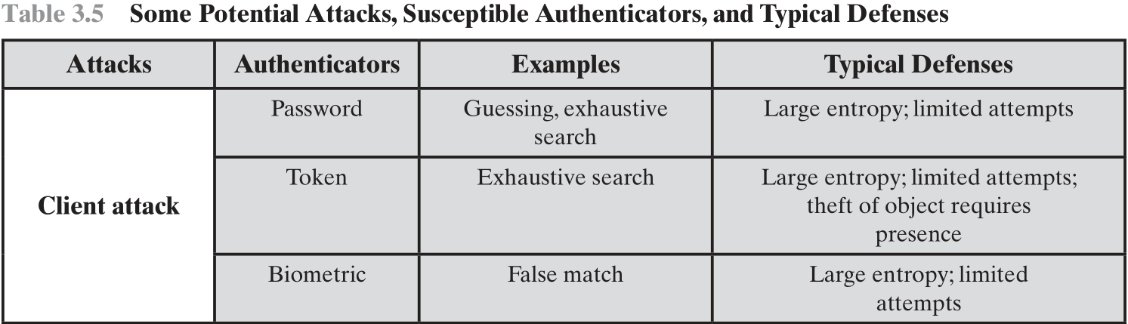
Security Issues for User Authentication

Slide 67
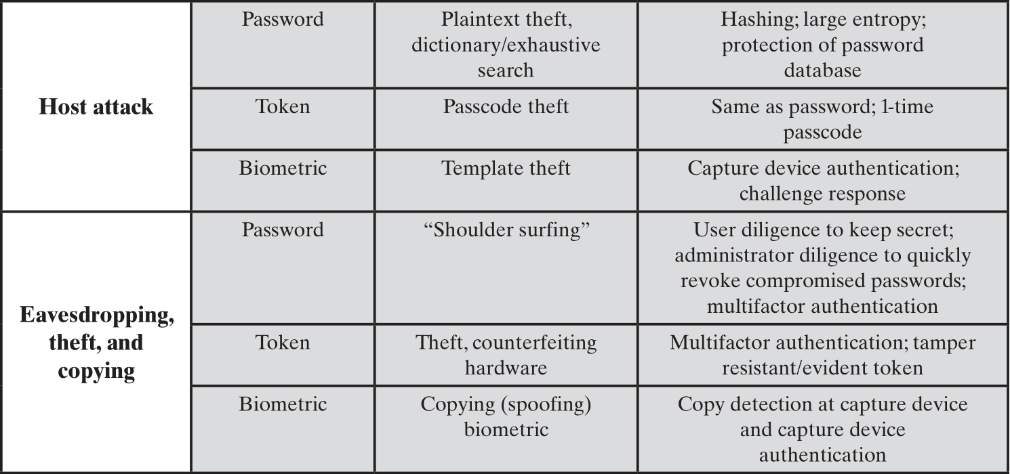

Slide 68


Slide 69

Practical Application: An Iris Biometric System
阿聯酋 UAE
入境安全監測
虹膜生物特徵認證系統

Slide 70
Case Study: Security Problems for ATM Systems
Principal vulnerabilities:
Confidentiality:
The card number, expiration date, and account balance can be used for online purchases or to create a duplicate card for signature-based transactions.
Integrity:
There is no protection to prevent an attacker from injecting or altering data in transit.
If an adversary is able to capture messages in route, the adversary can masquerade as either the processor or the ATM.
Direct the ATM to dispense money without the processor ever knowing
If an adversary captures a user’s account information and encrypted PIN, the account is compromised until the ATM encryption key is changed, enabling the adversary to modify account balances or effect transfers.

Slide 71

ATM Architectures
2003 年以前典型的架構
全部使用專線網路
Leased Line
EFT: Electronic Funds Transfer

Slide 72


ATM Architectures
2006 年起，IBM OS/2 被 Microsoft Windows 取代
通訊協定採用 TCP/IP
網際網路連線比專線便宜

Slide 73
Case Study: Security Problems for ATM Systems
Short-term fixes
Segmenting ATM traffic from the rest of the network
Implement strict firewall rule sets
Physically dividing the networks altogether
Implement network-level encryption between routers that the ATM traffic traverses.
Long-term fixes
Changes in the application-level software.
Protecting confidentiality requires encrypting all customer-related information that traverses the network.
Ensuring data integrity requires better machine-to-machine authentication between the ATM and processor and the use of challenge-response protocols to counter replay attacks.

Slide 74
Summary
Digital user authentication principles
A model for digital user authentication
Means of authentication
Risk assessment for user authentication
Password-based authentication
The vulnerability of passwords
The use of hashed passwords
Password cracking of user-chosen passwords
Password file access control
Password selection strategies
Token-based authentication
Memory cards
Smart cards
Electronic identity cards
Biometric authentication
Physical characteristics used in biometric applications
Operation of a biometric authentication system
Biometric accuracy
Remote user authentication
Password protocol
Token protocol
Static biometric protocol
Dynamic biometric protocol
Security issues for user authentication
Notes:
Chapter 3 summary.

